Slide 1
College at Brockport ARMY ROTC

Slide 2
What is ROTC?
Army ROTC (Reserve Officers' Training Corps) is one of the best leadership courses in the country and is part of your college curriculum.
During classes, leadership labs, physical training and field training exercises, you will learn first hand what it takes to lead others and conduct missions as an Officer in the United States Army.
Upon graduation from ROTC, you will earn a commission as a Second Lieutenant and serve in the Active Army, Army Reserve or Army National Guard.

Slide 3
What do Cadets learn?
Leadership Skills
Management Skills
Effective Communication Skills
Critical Thinking Skills
Coordination of Group Efforts
Organization of Large Projects
Moral and Ethical Conduct
Skills needed to be an Army Officer
Skills desired by civilian employers

Slide 4
Scholarship Opportunities
2, 3, or 4 year scholarships.
Full tuition covered or Full room and board
$1200/yr book allowance
$350-$500 monthly stipend
Service Obligation:
If selecting Active duty commitment is 4 years Active, then 4 years Reserve/Guard or 8 years Active
If selecting Reserve duty commitment is 8 years Reserve

Slide 5
Scholarship Opportunities
Guaranteed Reserve Force Duty (GRFD):
2, 3,year GRFD scholarships:
Must join the Army Reserve or National Guard after graduation
$1200/yr book allowance
$300-$500 monthly stipend
Must be part of the SMP Program (next slide)
Eligible for GI Bill
Tuition Assistance (up to $4500/yr)
can be combined with a Room and
Board GRFD Scholarship

Slide 6
Scholarship Opportunities
Simultaneous Membership Program (SMP)
Reserve | National Guard
Basic Training (minimum) ($4,500) Advanced Individual Training ($4,500+) | Basic Training (minimum) ($4,500) Advanced Individual Training ($4,500+)
Tuition Assistance (up to $4000/yr) | Tuition Assistance (up to $4500/yr)
GI Bill w/ Kicker: $700/mo and up to $20,000 bonus based on Job Specialty (individual basis)
Sergeant (E5) Pay: $265 drill weekend
Book Allowance: $1200/yr
Stipend: $300-500

Slide 7
Scholarship Eligibility
US Citizenship
Age 18-26 years (up to 31 for Veterans)
Cannot be older than 31 by December 31st of your graduation and commissioning year without prior military experience
Acceptance to the College or University
Must meet the Army Physical Fitness and Medical standards

Slide 8
ROTC Minor
NO military commitment required
Total of 5 Military Science classes
Ability to experience ROTC training without incurring a military obligation

Slide 9
Benefits
World-class leadership training
Opportunity to help protect and serve your nation
Learn invaluable team-building and decision-making skills
Financial assistance with paying for college
Military service looks great on a resume
Job security

Slide 10
Typical Weekly Cadet Schedule
Attend Regular College Classes
Attend ROTC Class (1 to 3 Hours)
Attend Fitness Training (MWF 6:30-7:30am)
Attend ROTC Lab (Thursday 3:30-5:30pm)
Participate in Extracurricular clubs, sports, events, etc… (your choice)
Field Training Exercise – 1 per semester – 4 days (students receive a pass request for missed classes)

Slide 11
Typical Training Events
Confidence Courses
Situational Training Exercises
Land Navigation
Combat Water Survival
Leadership Reaction Exercises
Drill and Ceremony
Weapon Familiarization
Physical Training
Field Training Exercises

Slide 12
Other Activities (Voluntary)
Color Guard
Military Science Club
Ranger Challenge
Intramural Sports / Clubs
Division III Athletics
Community and Fine Arts Events

Slide 13
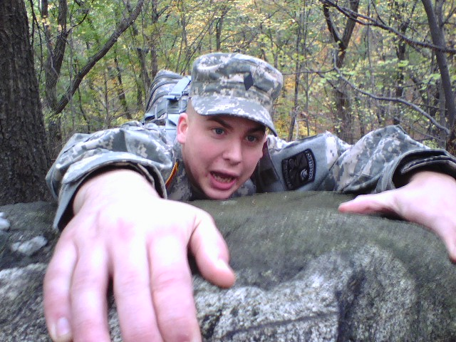
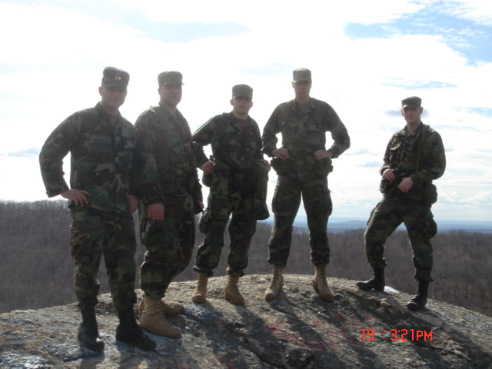
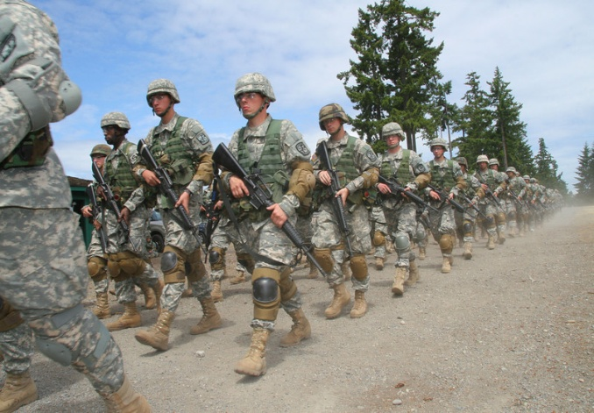
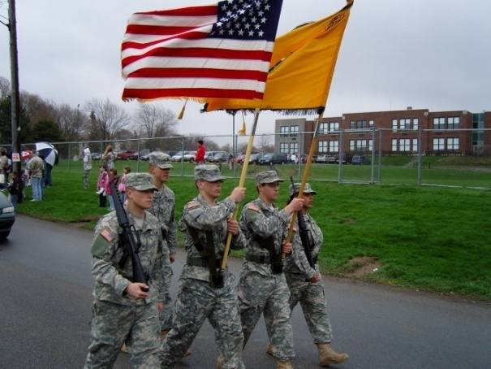
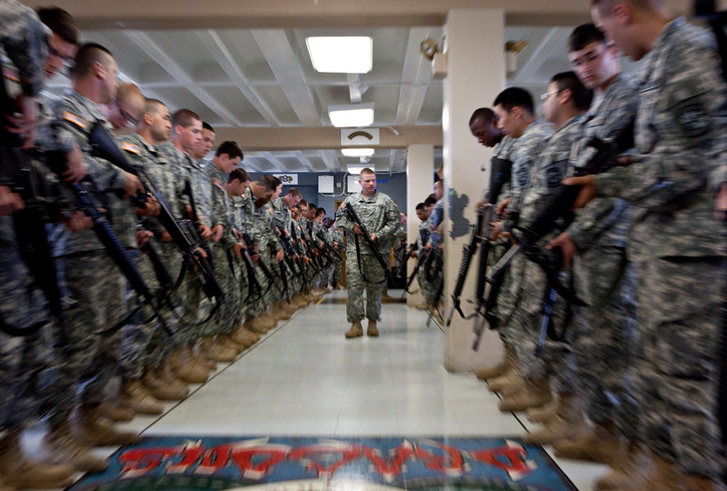
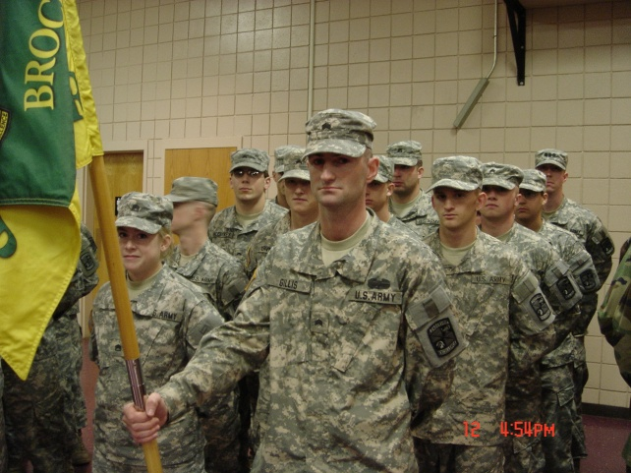
Training Pictures

Slide 14
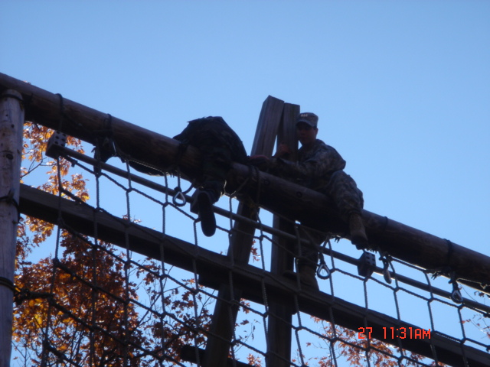
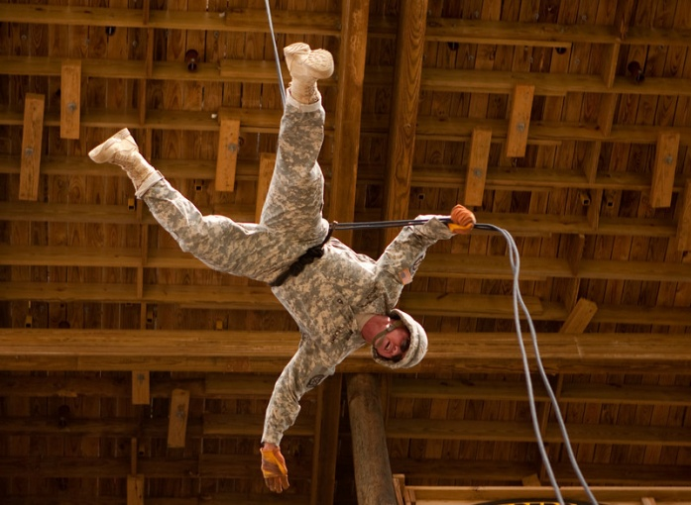
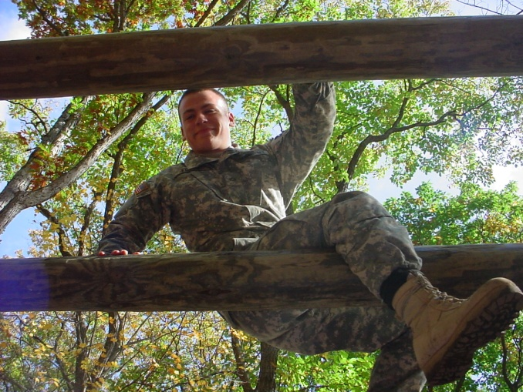
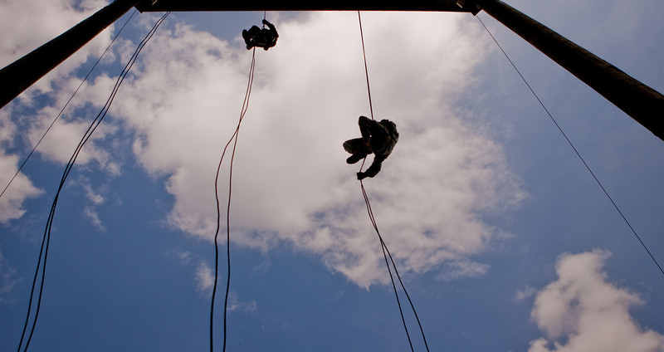
Training Pictures

Slide 15
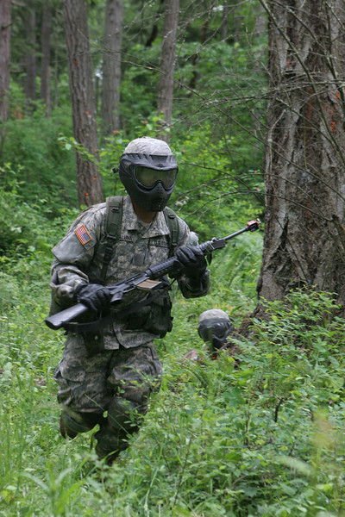
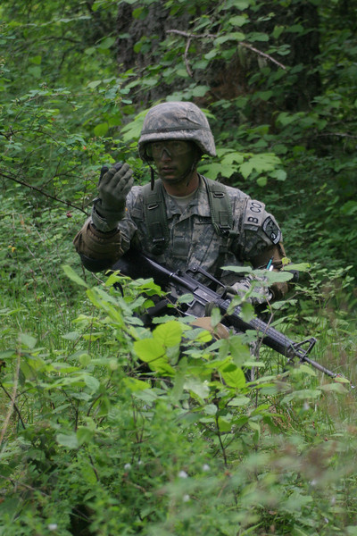
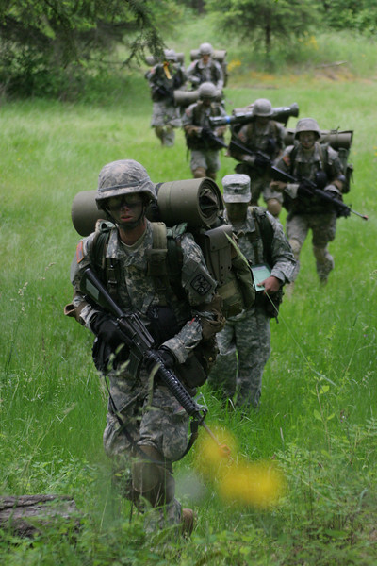
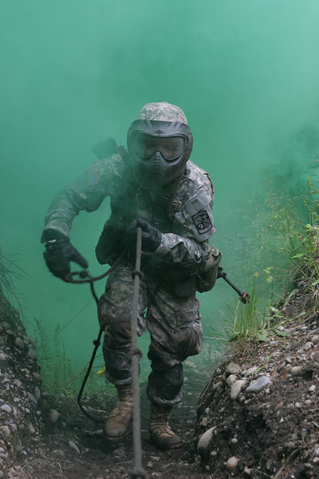
Training Pictures

Slide 16
Helpful Links for more information
http://www.brockport.edu
http://www.brockport.edu/armyrotc
http://www.goarmy.com/rotc/high-school-students/four-year-scholarship.html
http://www.rotc.usaac.army.mil/
http://www.brockport.edu/admissions
http://www.leaderstrainingcourse.com
http://dmna.state.ny.us/index.php

Slide 17
Questions?
http://www.brockport.edu/armyrotc
dfletche@brockport.edu
(585) 395-2769

